Slide 1
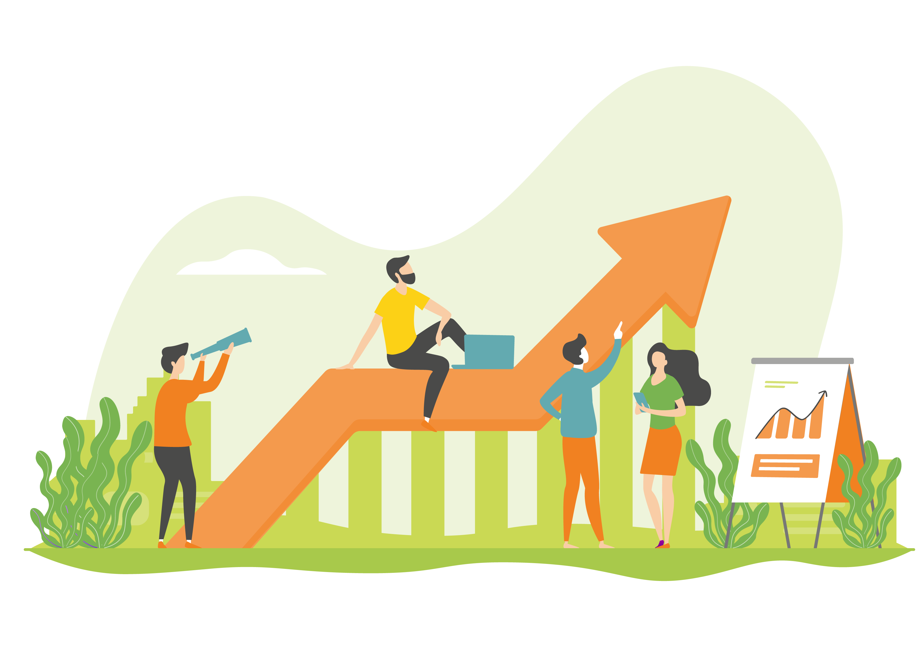
Senior specialists Seija Moilanen and Pirkko Mäkinen
Recovery as part of workload management
Images: The Centre for Occupational Safety; Milla Toro;
BigStock; Pixabay CC0 license

Slide 2
What are the workplace Safety Moments like?
Pausing together to look at ways to improve occupational safety and approaches that make work easier.
The idea is to choose one relevant workplace topic at a time to discuss and develop together.
The goal is to achieve a permanent change for the better, even a small one.
The duration of a Safety Moment can vary depending on the needs and schedules of the workplace, from 15 to 30 minutes, for example.
(Image: Milla Toro)
Seija Moilanen, Twitter @SeijaMoi
4.11.2022

Slide 3
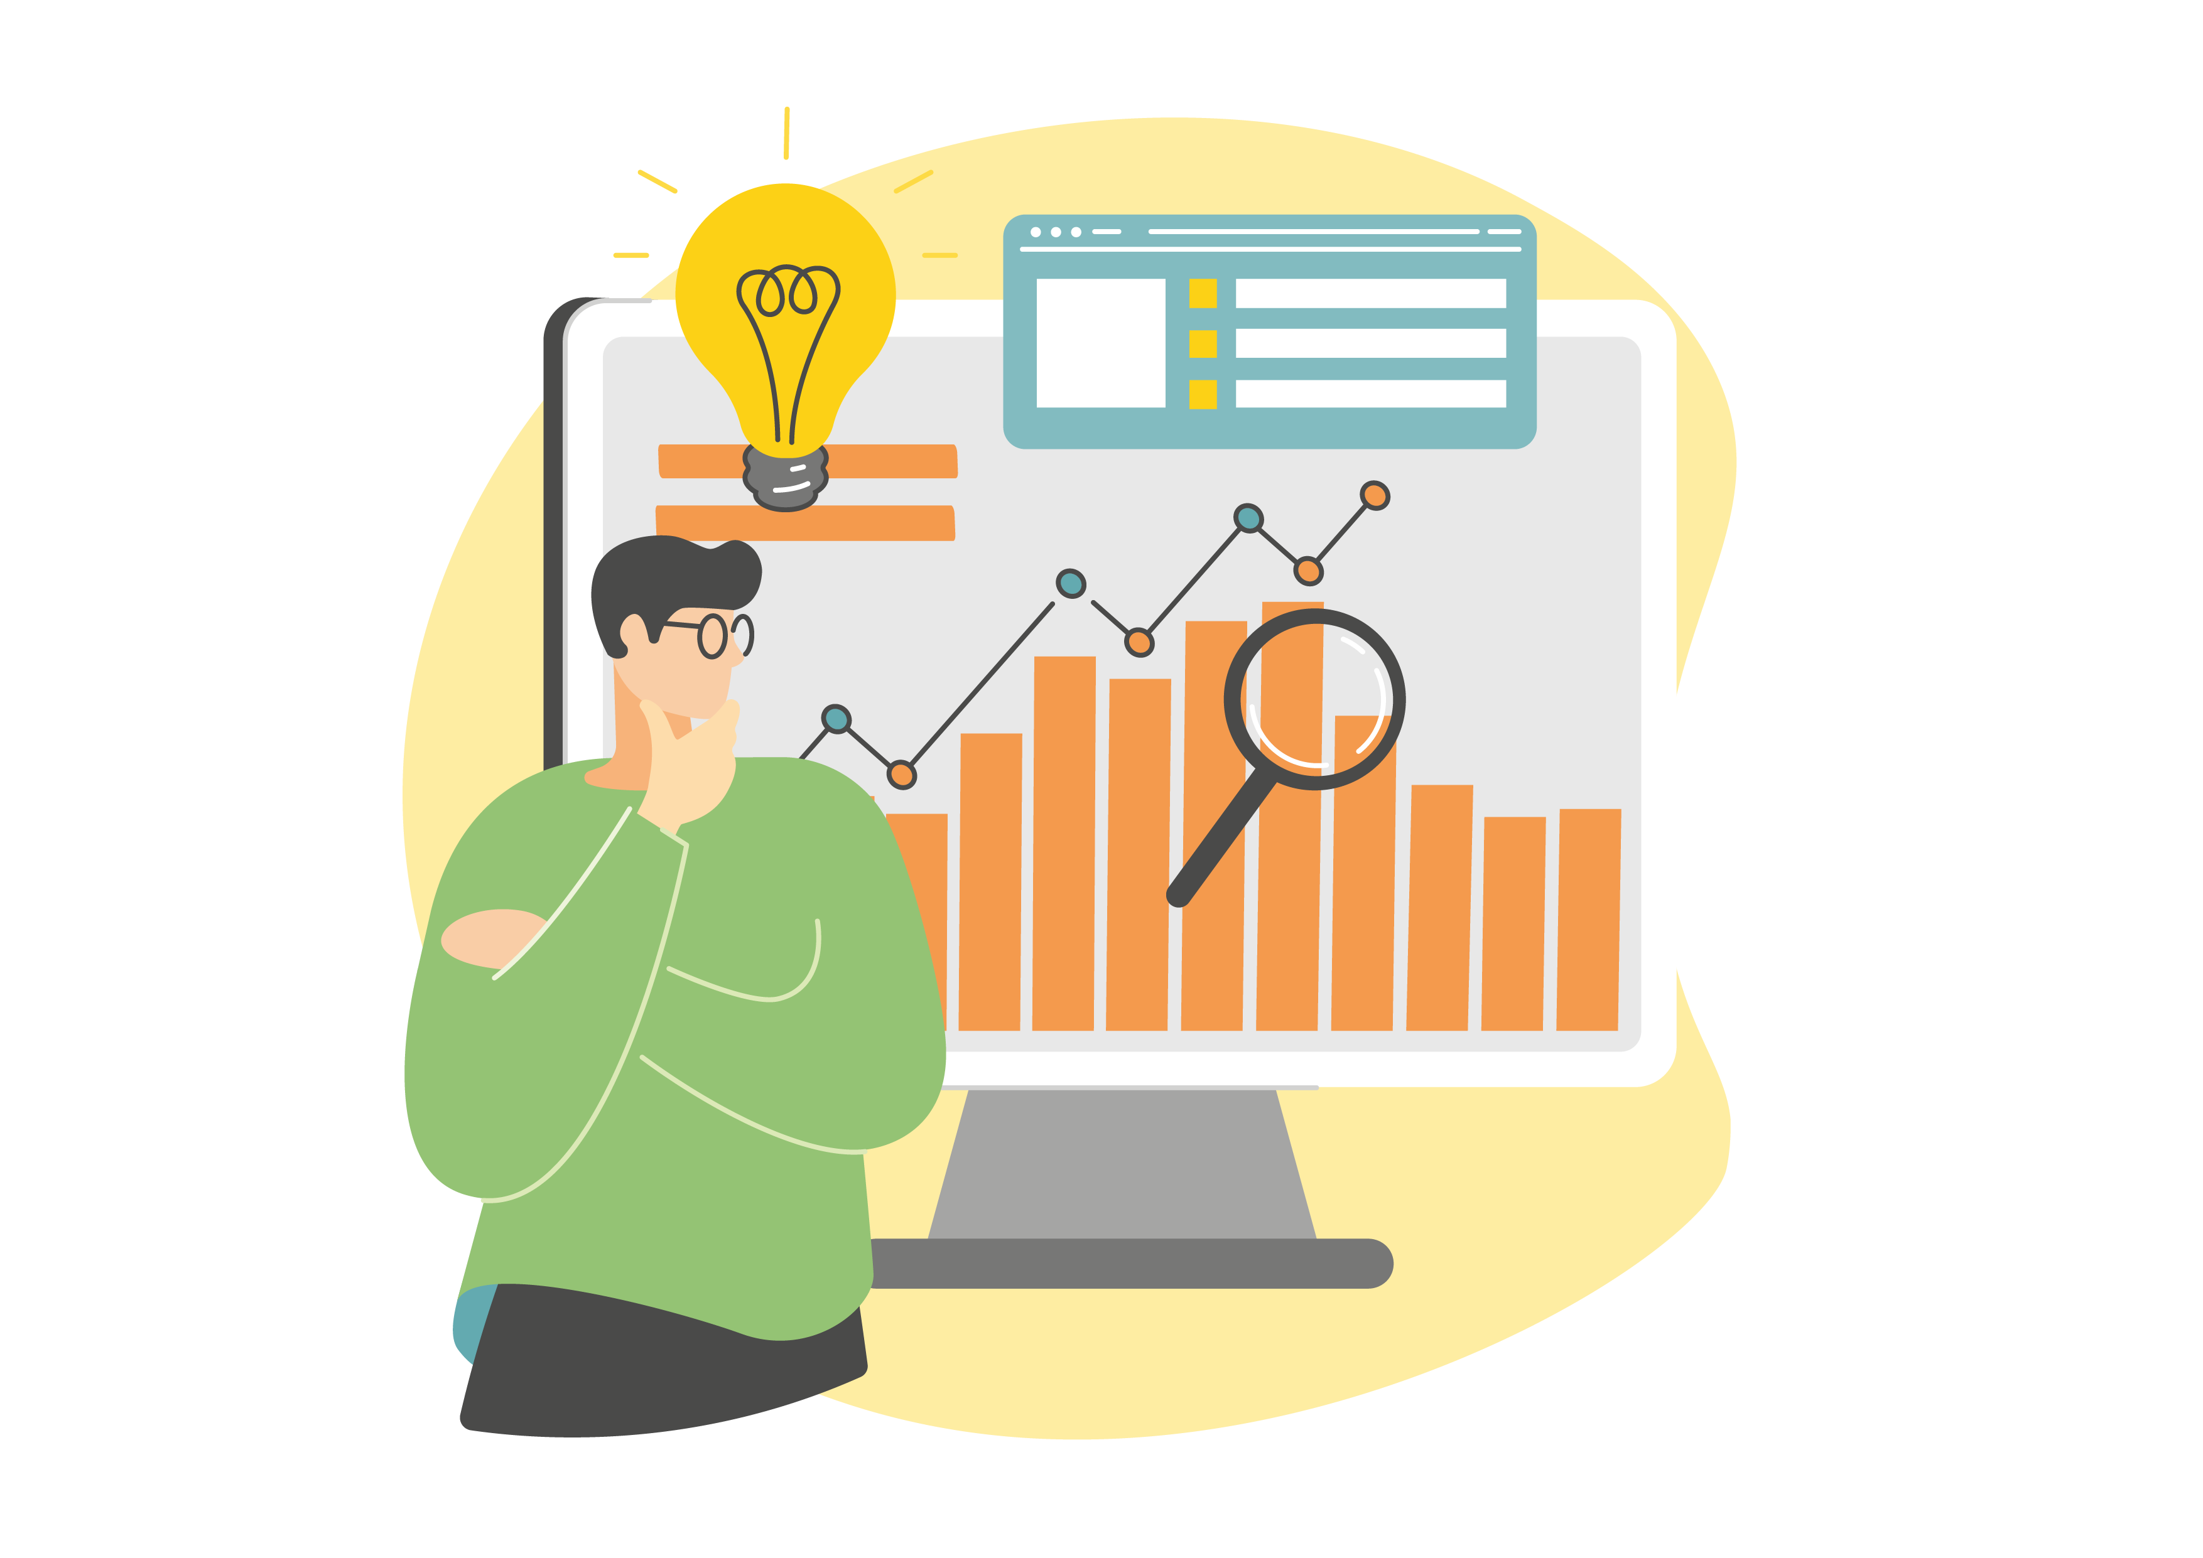
What support do we offer the Safety Moment instructor?
Safety Moment materials, which the instructor can use to conduct a Safety Moment in the workplace
A Safety Moment instructor webinar in which we present the materials and guide you in conducting a Safety Moment. At the same time, you will start planning a Safety Moment to be conducted at your workplace.
Together with us you will discuss and learn about making use of a Safety Moment.
An annual invitation to a webinar for those who have participated in the Safety Moment webinars
Safety Moment website
(Image: Milla Toro)
Seija Moilanen, Twitter @SeijaMoi
4.11.2022

Slide 4
Safety Moment materials: Recovery as part of workload management

Slide 5
An overview on workload factors
≠
Work demands
One’s strengths, ideas, prerequisites and preparedness
Also e.g. inner speech
Physical, quantitative and qualitative
≠
The work’s and workplace’s
rewards and possibilities
One’s expectations,
hopes and needs
Work task, work community and employer
Recovery
Seija Moilanen, Twitter @SeijaMoi
4.11.2022

Slide 6
The cornerstones of recovery
The employer must provide opportunities to recover during working days or shifts (e.g. work planning and variety, recovery incentives, a work-free meal break, transitions between customers or meetings, etc.)
It is important that each of us makes use of the opportunities to recover offered by the employer during working days or work shifts.
It is important that we ensure we recover from work in our free time.
Remember: we cannot store up recovery.
Seija Moilanen, Twitter @SeijaMoi

Slide 7
The Taking short work breaks animation (in Finnish) brings up examples of ways to take breaks and invigorating movements

Slide 8
Even short breaks are important (Bennett, A.A., Gabriel, A.S. & Calderwood, C. 2020. Examining the interplay of micro-break durations and activities for employee recovery: A mixed-methods investigation. Journal of Occupational Health Psychology, Vol 25(2), Apr 2020, 126-142)
Simulated, randomized research design (3 groups and a control group)
Watching a funny video; watching a guided meditation video; switching from one work task to another similar work task
Duration: 1, 5 and 9 minutes for each group
All breaks had, at least, a small effect on energy replenishment. The breaks helped with recovery, even full recovery.
Those who had watched the funny video reported (regardless of the length) much less tiredness. They also enjoyed the breaks more than the others.
Based on the research it seems that changing tasks for a moment can support recovery and momentarily decrease tiredness.
Seija Moilanen, Twitter @SeijaMoi

Slide 9
Move in nature – or stop by virtually
Luke, Research Professor Liisa Tyrväinen: “Based on the results, recovery from stress during working days can [also] be enhanced by virtual nature.”
University of Exeter, senior lecturer in environmental psychology Matthew White:
“Spending two hours a week in nature is linked to better health and well-being.”

Slide 10
Order a daily break exercise workout from Selkäkanava (free of charge, in Finnish)
Image: BigStock

Slide 11
Different types of rest
Physical rest
Mental rest
Sensory rest
Creative rest
Emotional rest
Social rest
How well are you implementing these
into your day or week?
Seija Moilanen, Twitter @SeijaMoi

Slide 12
The Everyone needs recovery video brings up examples of ways to recover

Slide 13
DRAMMA – supporting recovery
(Detachment)
(Relaxation)
(Autonomy)
(Mastery)
(Meaning)
(Affiliation)
(Anniina Virtanen (2021). Psykologinen palautuminen.)
How well are you implementing these
into your day or week?
Seija Moilanen, Twitter @SeijaMoi

Slide 14
How can I ensure that I recover from work in the workplace and in my free time?
Breaks of different lengths
Occasionally staring out of the window
Taking breaks, either alone or chatting with colleagues
Smiling, laughing, watching funny videos
Meal and coffee breaks (also in remote work!)
Leaving your working spot on breaks
Break exercise, brain exercise
Walking meetings
Shorter meetings
Organization of work
One work task at a time, if possible
Allowing that a task can be left unfinished until tomorrow
Controlled variation of work tasks
Tracking work time
Preparing for new situations
Limiting work time and minimizing overtime work
Handling emails and other messages during working hours
Having separate phones for work and free time
Getting a good night’s sleep
Maintaining regular meal times
Outdoor recreation, exercise, walking in nature, hiking
Yardwork and gardening
Renovations
Hobbies (your own and your children’s)
Friends
Doing things you enjoy
Independent study
Volunteer work
Calling a friend or a loved one
Reading and audio books
Crafts and handicrafts
Music, choral singing
Concerts, exhibitions, movies
Jigsaw puzzles, crossword puzzles
Relaxation techniques
Meditation
Seija Moilanen, Twitter @SeijaMoi

Slide 15
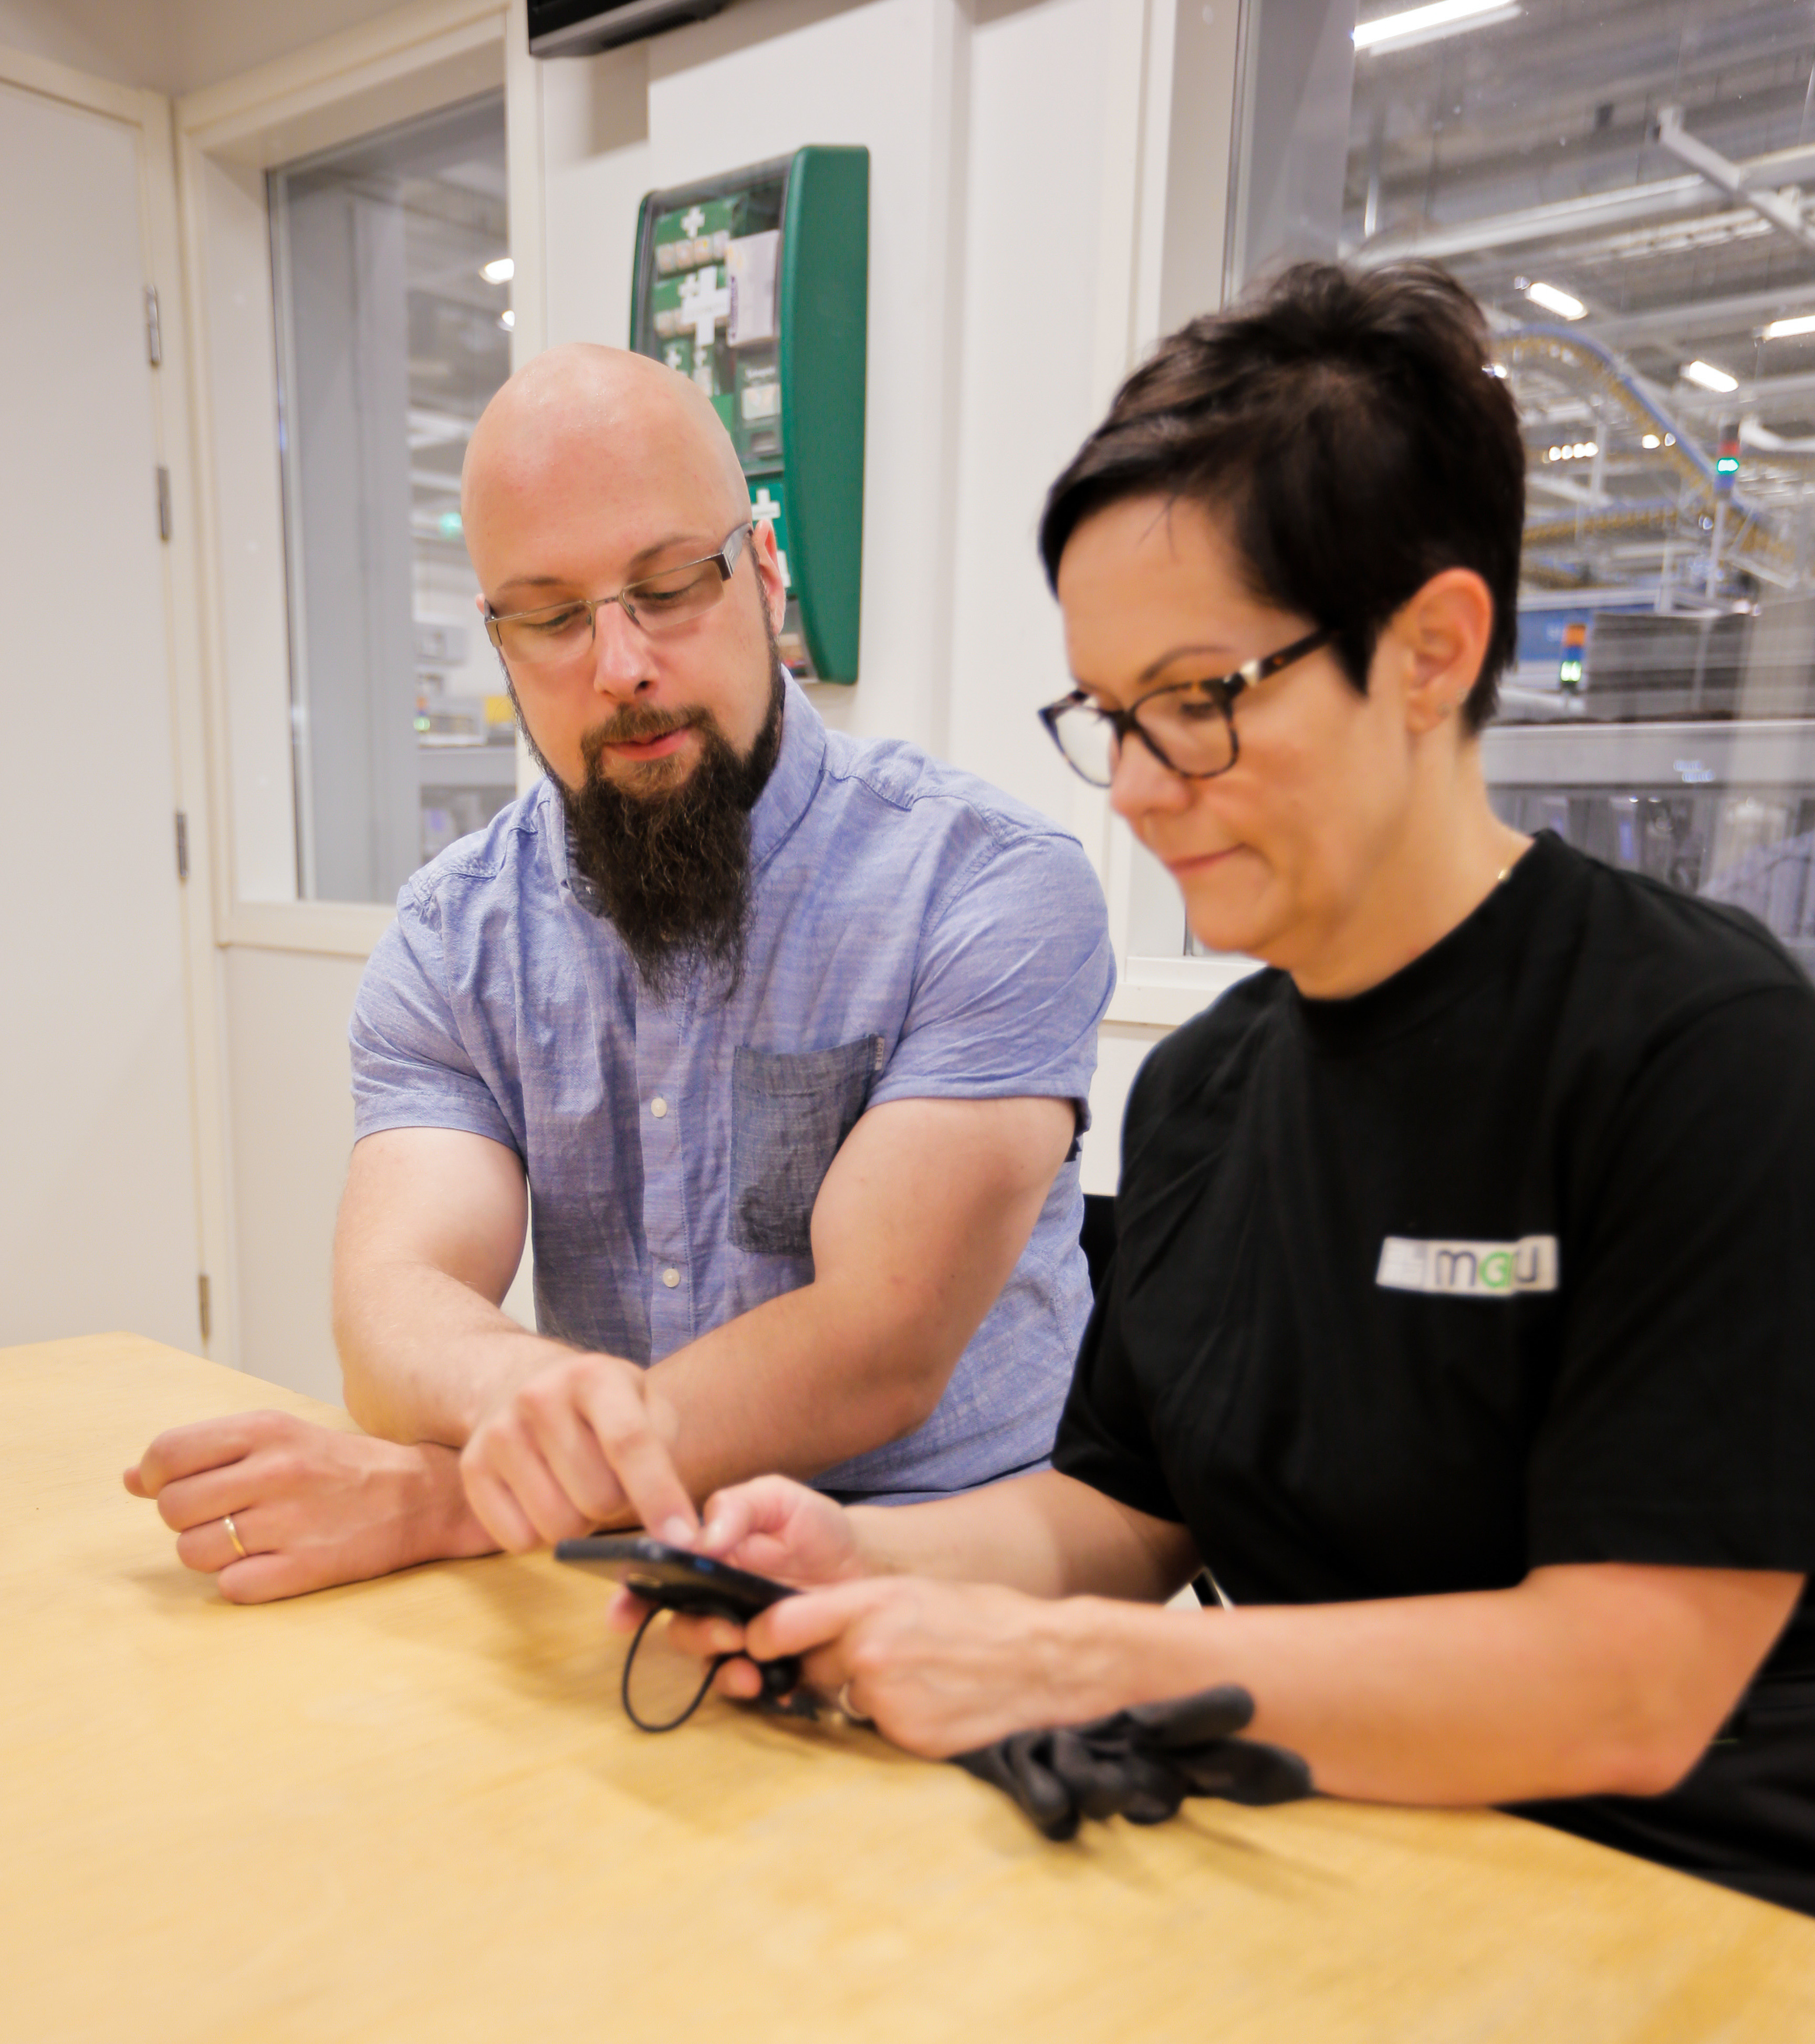
Your workplace’s development needs
Which development needs do we have related to recovery protocols and possibilities?

Slide 16
You should remember these three steps when planning a Safety Moment in your workplace
Preparing the moment
Where?
Conducting the moment
Introduce the topic and explain why it is relevant in your workplace
After the moment
Make sure that the target for development is present in everyday work
For whom?
Why?
When?
Come up with one thing related to the topic that should be developed
Agree on the development measure
How?
Invite participants to discuss the topic and work together
Agree on the monitoring schedule
Make sure that you come back to the topic according to the agreed on schedule
Think about a topic for the next Safety Moment
Utilize the Safety Moment materials of the Centre for Occupational Safety
What?

Slide 17
The topic of your own workplace Safety Moment: Date: Workplace team/group/department:
Preparing the moment | Conducting the moment | After the moment

Slide 18
Additional materials
The Centre for Occupational Safety: Recovery Calculator
The Centre for Occupational Safety: Calm moment video
The Centre for Occupational Safety: Working time website (in Finnish)
Seija Moilanen, Twitter @SeijaMoi

Slide 19
Thank you for your time and interest.
We wish you fruitful Safety Moments in your own workplace!
Further information on the Safety Moment concept will be provided by
Senior specialist Sari Aksberg and Customer Relations and Development Director Jarna Savolainen.
Further information on the topics of this Safety Moment will be provided by Senior specialists Seija Moilanen and Pirkko Mäkinen.
You can contact us via email at firstname.surname@ttk.fi

